Slide 1
Email Tracking System
Mohammad Ali
Mayanka Chandra Shekar
Bharat Viswanadham
Prakash Reddy Vaka

Slide 2
Email Tracking System
To find the device used for reading the emails.
This is project is done to give the statistics for email broad casters.
Top users interested in their email’s.
Statistics of devices used for reading emails.
Count of users viewed their emails.

Slide 3
Email Tracking System
Features:
Email Broadcaster
Detection of user device
Top interested users.
Distribution of user devices.
Statistics of broadcasted mails.

Slide 4
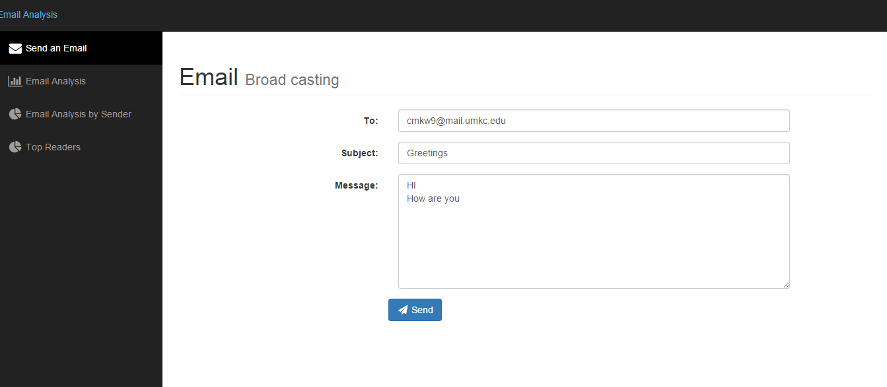
Email Sender

Slide 5
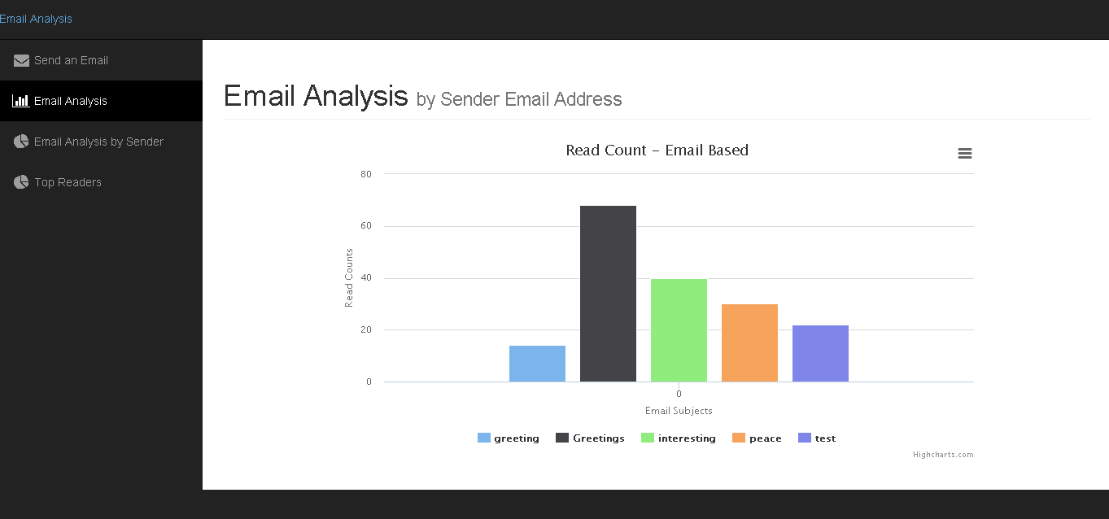
Statistics of broadcasted mails

Slide 6
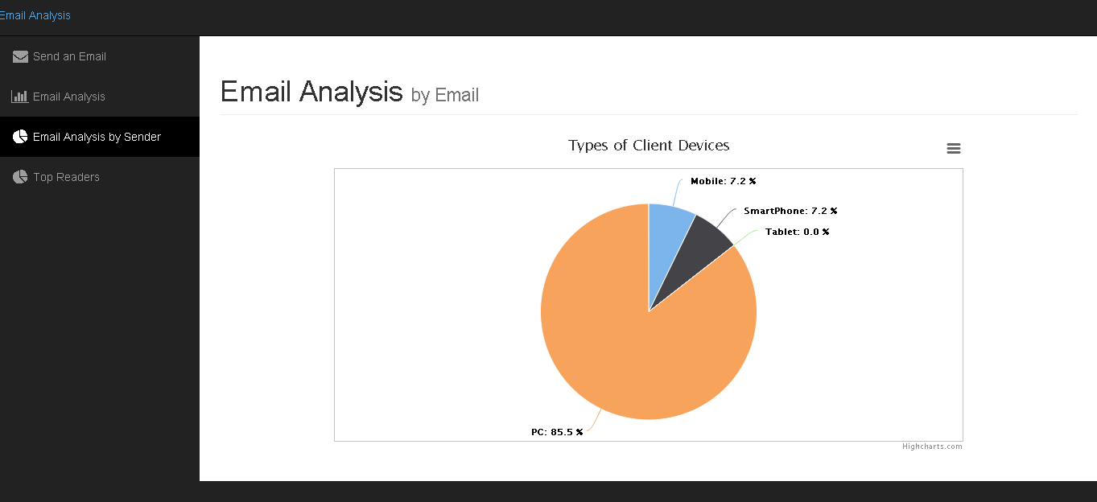
Distribution of user devices.

Slide 7
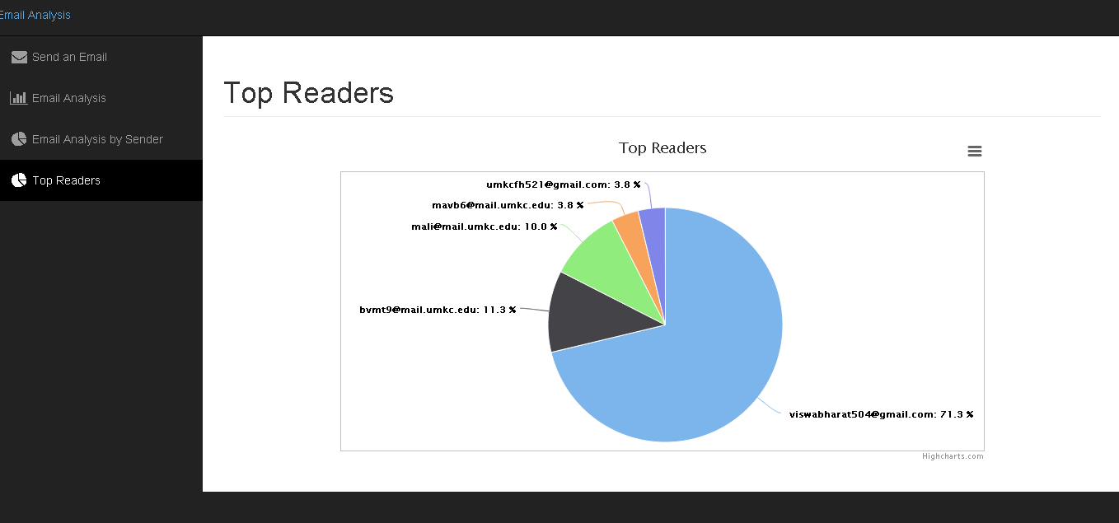
Top interested users.

Slide 8
References:
http://wurfl.sourceforge.net/

